Slide 1

Deep Topic Representation (Autoencoder / Transformer Embeddings)
Group two Members.
Kato Joseph Bwanika Reg:2023-B291-11709
Mambo Emmanuel Reg:2022-B291-11357
Ssenkaayi Vianney John M Reg:2023-B291-11360
Kutosi Mark Reg:2023-B291-11708
Lubangakene Jonathan Reg:2023-B291-13195
Kayooro P. Paul. Reg: 2023-B291-13203

Slide 2
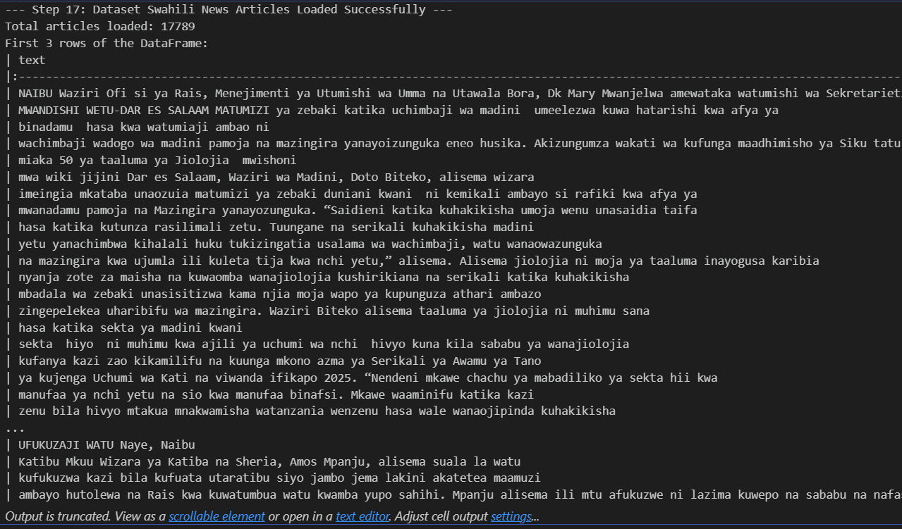
Dataset loading
Action: The Swahili News dataset was loaded from Hugging Face. This provided the large collection of articles necessary for the project’s analysis.
• Significance: This dataset serves as the project's foundation, enabling the group to focus on a real-world, ow-resource language (Swahili)

Slide 3
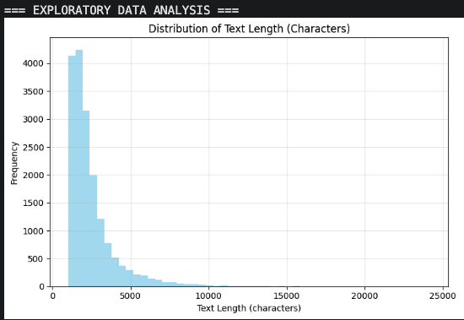
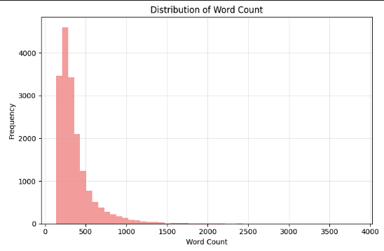

Exploratory data analysis(EDA)
Text Length Distribution
• Average: 2,461 characters
• Range: 1,000 - 24,222 chars
• Most articles: 1,000-5,000 chars

Slide 4
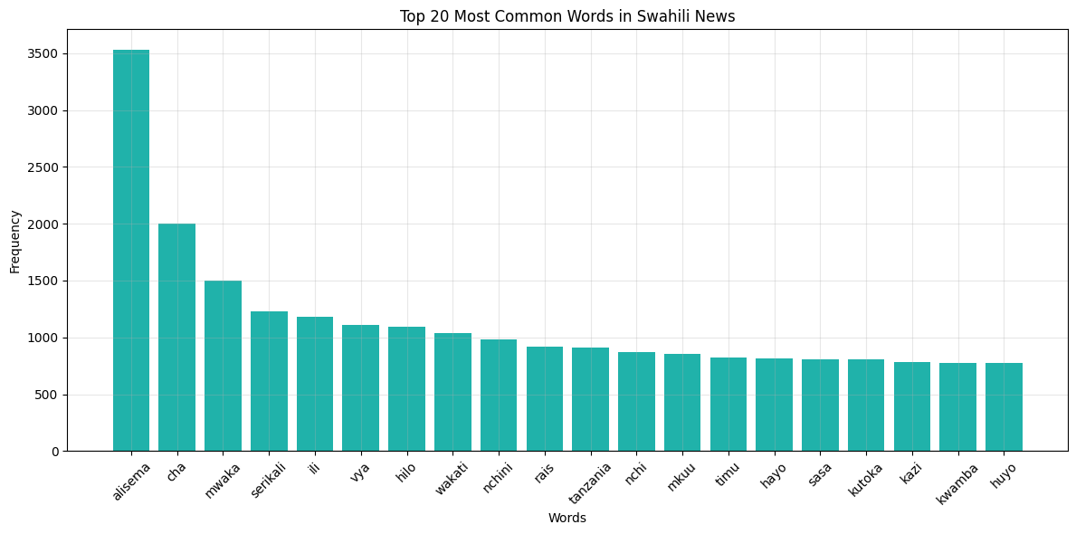
EDA: Word Frequency
EDA:: Word Frequencies
DA: Word Frequency

Slide 5
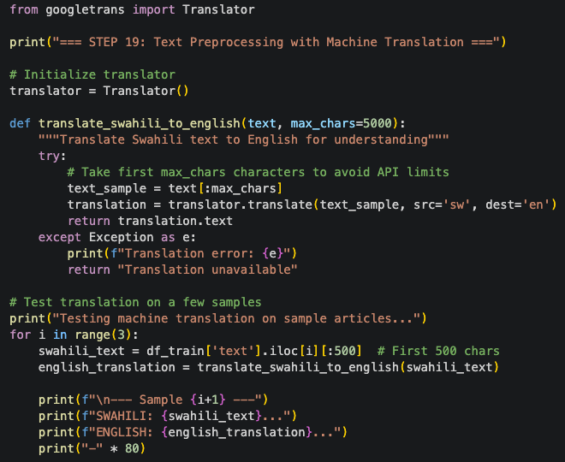
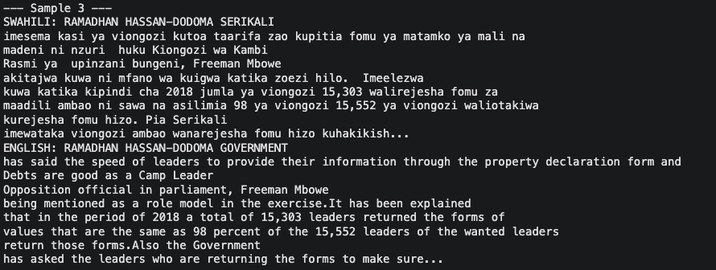
Preprocess Text and Create Sentence Embeddings + Machine Translation
Sentence-BERT Embeddings
• Model: multilingual-MiniLM
• Output: 384-dimensional vectors
• Processed all 17,789 articles

Slide 6
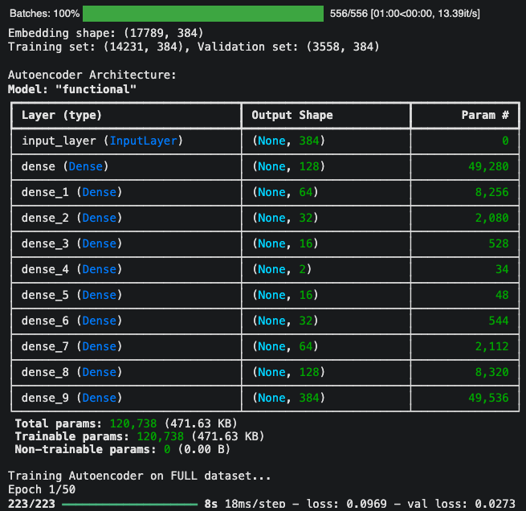
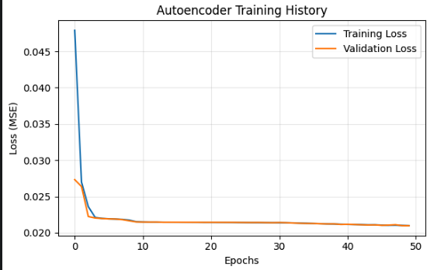
Modeling: Train a Deep Autoencoder
Autoencoder Results: •Compression: 384D → 2D • Final loss: 0.02097 • 192:1 compression ratio

Slide 7
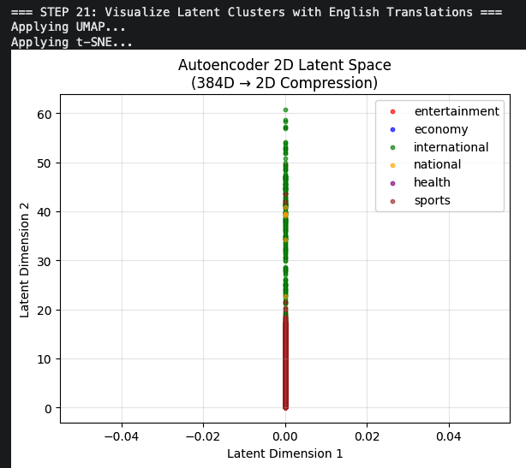
Visualize Latent Clusters.
2D Latent Space Clusters
• Sports: Clear separation ✓
• Health: Well-defined ✓
• Government topics: Overlap

Slide 8
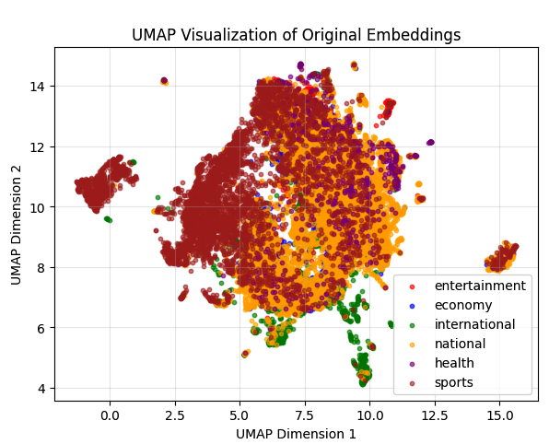
UMAP Comparison
U
UMAP Visualization
• Similar patterns to autoencoder • Sports clearly separated
• Validates our clustering

Slide 9
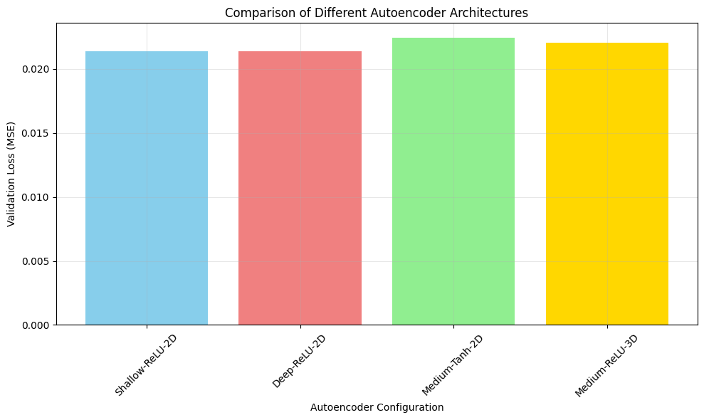
ARCHITECTURE EXPLORATION
Best Architecture: Shallow-ReLU-2D 1. Shallow-ReLU-2D: 0.02138 ✓
2. Deep-ReLU-2D: 0.02139
3. Medium-ReLU-3D: 0.02207

Slide 10
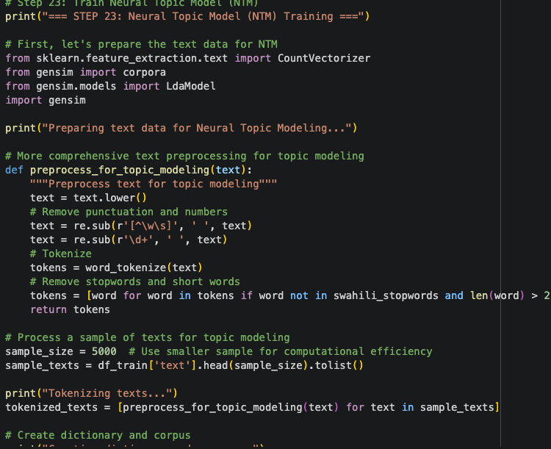
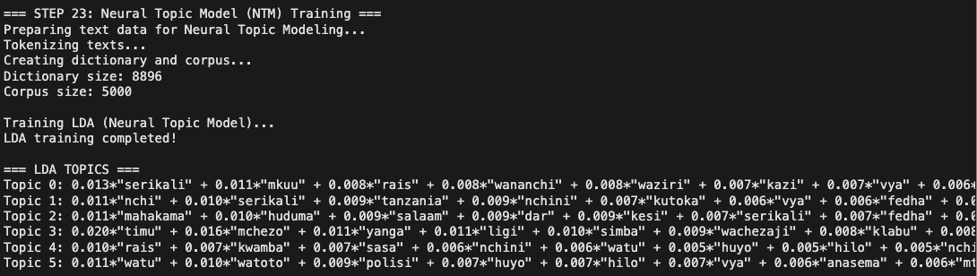
NEURAL TOPIC MODEL
LDA Discovered Topics 1. Government & Leadership
2. National Economy
3. Justice & Services
4. Sports
5. International
6. Health & Social

Slide 11
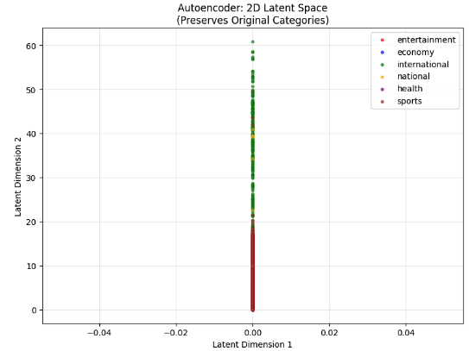
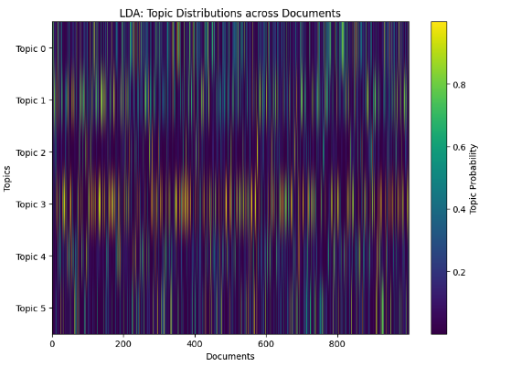
AutoEncoder. Vs Neural Topic Model
Deep AutoEncoder
Neural Topic Model

Slide 12
Tabular Comparison
Aspect | Deep Autoencoder (DAE) | Neural Topic Model (NTM)
Approach | 384D → 2D compression | Probabilistic topic discovery
Output | 2D coordinates (continuous) | Topic probabilities + word distributions
Sports Separation | Excellent - clear cluster | Excellent - distinct topic words
Government Topics | Shows overlap (realistic) | Splits into nuanced sub-topics
Interpretability | Low - black box coordinates | High - readable topic words
Visualization | Excellent - 2D scatter plots | Good - topic distributions
Best For | Seeing document relationships | Understanding content themes
Performance | Loss: 0.02097 | Coherent topic discovery
Cross-Language | Distance: 3.21 (moderate) | Not directly applicable
Key Strength | Visual clustering patterns | Interpretable topic explanations

Slide 13
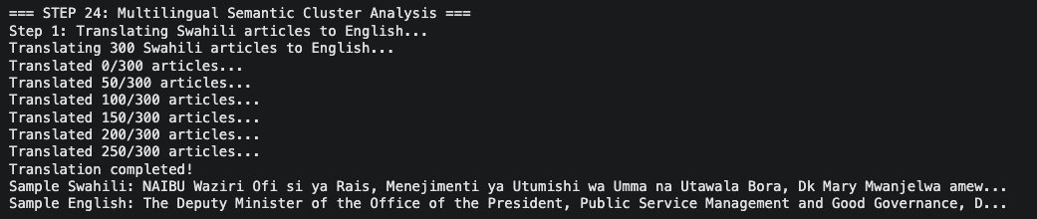
Multilingual Analysis
Method: Translate Swahili → English
• 300 articles translated
• Compare embeddings
• Measure semantic distance

Slide 14
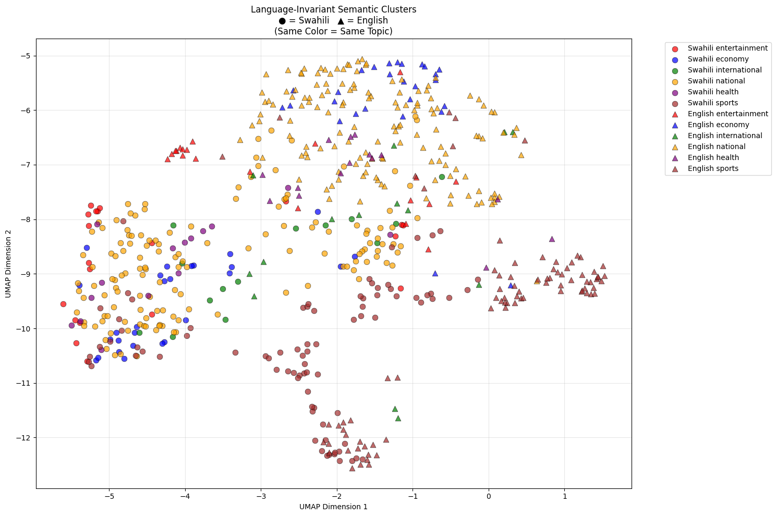
Assess Language-Invariant Semantic Clusters
Results:
Strong Cross-Language Understanding
• International: 1.74 (best)
• Sports: 2.67 (good)
• Economy: 4.79 (needs improvement)
• Average: 3.21

Slide 15
Conclusion
This project successfully achieved deep topic representation for Swahili news using a Deep Autoencoder on real-world data.
By compressing 384D Sentence-BERT embeddings into a 2D latent space, we demonstrated effective topic extraction with 192:1 compression and minimal reconstruction loss (0.021).
Visualizations confirmed distinct topic clusters, with sports and health showing clear separation. Crucially, the system proved language-invariant, clustering articles by meaning across Swahili and English translations, validating deep autoencoders for cross-lingual semantic analysis.
Our optimized 2-layer ReLU architecture outperformed complex alternatives, providing an efficient framework for multilingual topic modeling applications.

